Slide 1
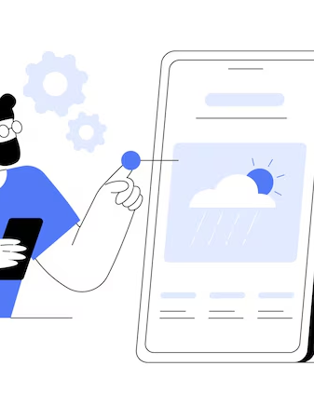
Weather App
Barani Kumar J K - 23BAI1566
Gowshika M - 23BCE1849

Slide 2
Introduction
This Weather App is a simple and user-friendly Android application built with Jetpack Compose. It gives real-time weather updates, showing the current temperature, conditions, and a quick forecast for selected cities. Designed with visual elements like icons and colors that reflect the weather, the app makes it easy for anyone to use it easily.

Slide 3
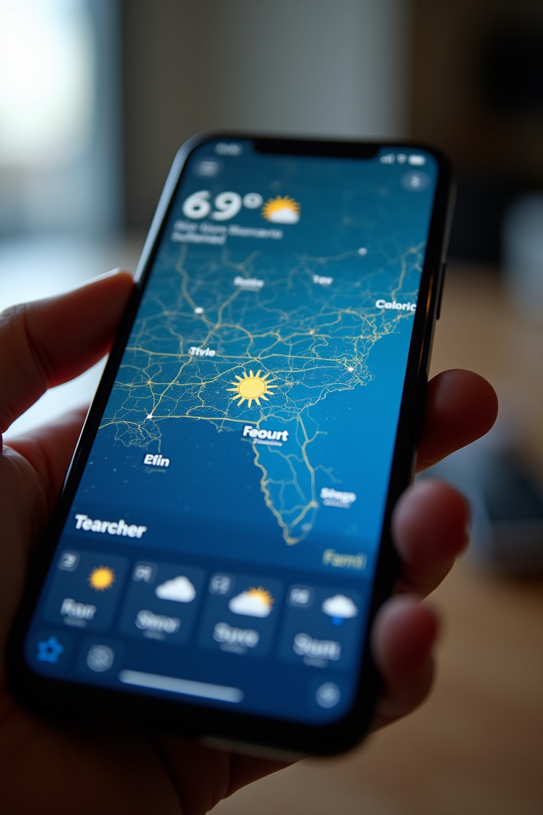
App Overview

Slide 4
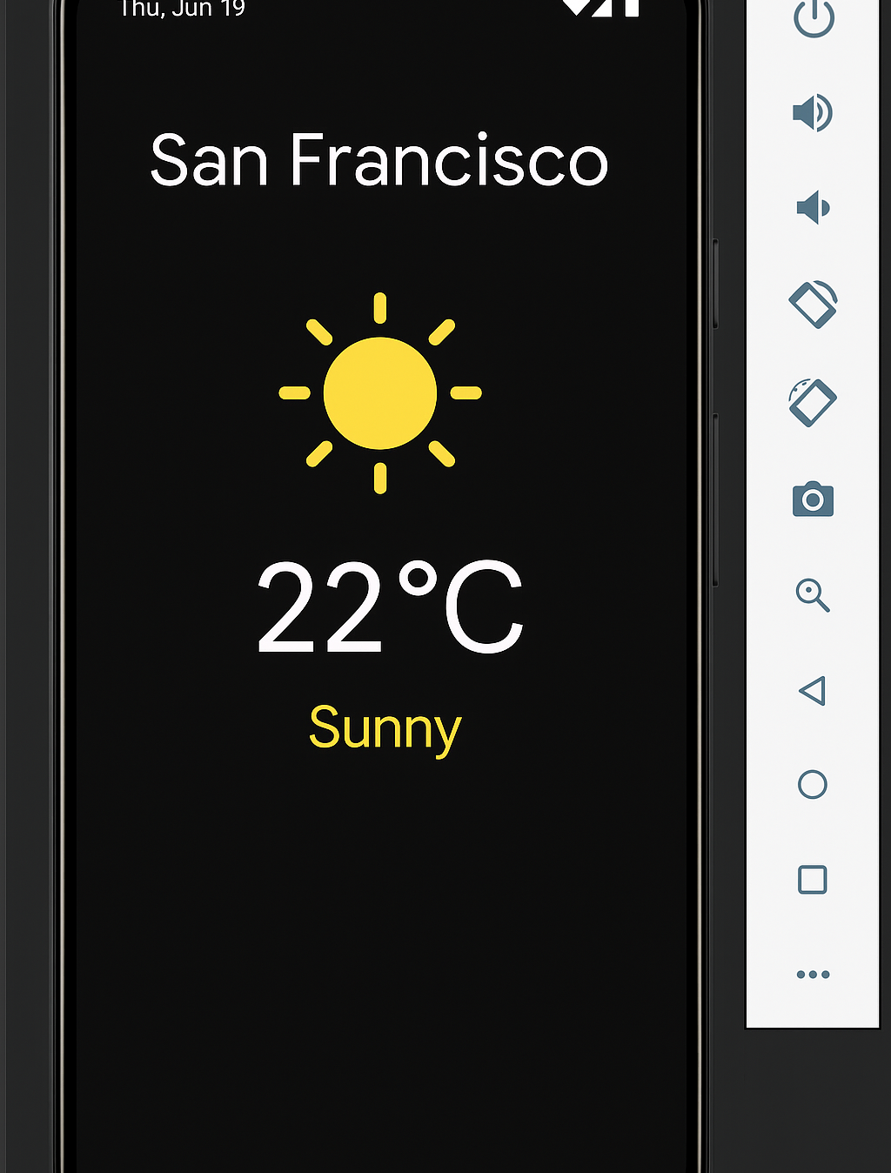
Weather App
The Weather APP is designed to provide accurate and real-time weather information. It features a user-friendly interface, integrating various weather data sources to enhance user experience. An accompanying image showcases the app's main screen.

Slide 5
Team Details
Team Name: Byte Surge Team members:
Barani Kumar J K | 23BAI1566 | Batch 1 | CSE | Year 2
Gowshika M | 23BCE1849 | Batch 1 | CSE | Year 2

Slide 6
Problem Overview
Problem Identification:
Many weather apps today rely on static or limited data sources that are not updated in real-time. Without integrating weather APIs or machine learning models, their forecasts often lack precision and fail to reflect sudden climate shifts. Users are left with generic, outdated, or inaccurate predictions that don’t match real-world conditions.
User Impact:
Users often rely on weather apps for daily planning, travel decisions, or event scheduling. When forecasts are inaccurate or delayed, it causes disruptions and reduces trust. In critical scenarios, like outdoor work or health-sensitive decisions, this can directly affect safety and productivity

Slide 7
Problem Overview
Market Gap Analysis:
Many apps in the market still function with minimal or no real-time API integration, and very few utilize machine learning to refine predictions based on historical data patterns. This leaves a gap for intelligent, data-driven forecasting tools that can offer more localized and adaptive results, especially in rapidly changing weather zones.
Problem Validation:
Through secondary research, user feedback, and an analysis of top weather apps, we found that accuracy and responsiveness are common user complaints. Surveys and reviews highlight demand for smarter, adaptive forecasting — validating the need for a solution that evolves with data and user behavior.

Slide 8
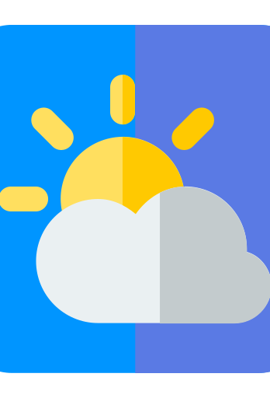
Solution and Implementation

Slide 9
Proposed Solution
Core Innovative:
Our weather forecast website tackles the problem of inaccuracy by combining real-time weather APIs with machine learning. Instead of relying on outdated or static data, it pulls in live weather information and uses predictive models to generate more reliable and up-to-date forecasts.
Key benefits:
Users get weather updates that are not only current but also tailored to their location. The interface is simple and easy to use, and the system improves over time by learning from past weather patterns. This makes the forecasts more personal, timely, and useful for everyday planning.

Slide 10
Proposed Solution
Technical Edge:
The platform is built using modern web technologies and is powered by machine learning and API integrations. It runs on a scalable backend that handles live data efficiently, setting it apart from basic apps that can’t adapt to changing conditions or user needs.

Slide 11
Each Member Contribution
Gowshika.M-
Designed and developed the UI using ViewPager2 and ConstraintLayout
Integrated OpenWeatherMap API using Retrofit - Implemented ViewPager horizontal city swiping - Set up API key, permissions, and testing on Android Emulator - Deployed app and uploaded project to GitHub
Barani Kumar jk –
Created WeatherModel, WeatherResponse, and adapter classes - Handled JSON parsing and built Retrofit services - Implemented RecyclerView weather cards - Designed weather_item.xml with dynamic data binding - Assisted with Git setup and version control collaboration

Slide 12
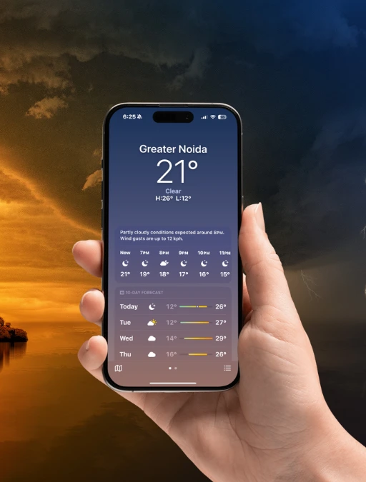
Conclusion
Weather plays a big role in our day-to-day lives, and having reliable forecasts makes planning easier. This app takes a smarter approach by using real-time data and machine learning to give more accurate, location-based predictions. It’s simple to use, adapts over time, and aims to solve the frustrations people often face with regular weather apps.

Slide 13
Thank You!

